Slide 1

Pandemic control in smart cities
Rifa Safeer Shah & Zixi Liu

Slide 2




contents
introduction
Movement path tracking technologies
Covid-19 prevention
conclusion
COVID-19 pandemic background
ICCC system, Health QR code, Sensors
Sensors and M-SEIR urban morphology model
Pandemic prevention with technology in Smart Cities

Slide 3

1. introduction
The outbreak of COVID-19 pandemic worldwide has brought huge challenges to urban governance
Smart cities program play an important role in the prevention and control of such pandemics.

Slide 4
2. Movement path tracking technologies
Health qR code
Sensors in smart cities
ICCC system & facial recognition system
Exposure risk
Contact and movement pathway tracing
Objectives and Purpose of Sensor Technology
Sensor Data Collection
Lockdown tracking and monitoring, citizen support and assistance
Quarantine centre surveillance system

Slide 5
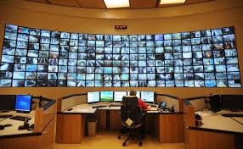
2.1. Integrated command and control centre system
For management of operations, management of disasters and handling of exceptions on daily basis the foremost and important source/intelligence is provided by integrated command and control centre or the ICCC.
Data of complex nature are processed at a comprehensive level. Thus, it provides intelligence for formulating policies and better planning. Information and data are collected through various sensors and applications which are positioned across a certain location. After the analysis of information or data some suitable and workable details are put forward to act upon.

Slide 6
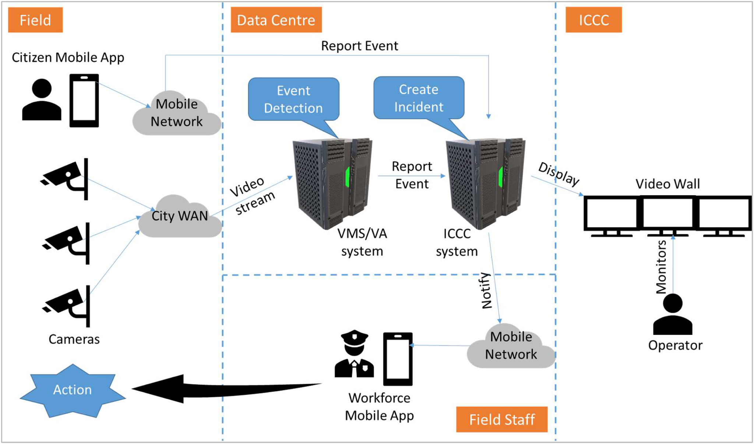
Lockdown tracking and monitoring, citizen support and assistance
Step 1: Identify potential and vulnerable locations of crowd gathering such as marketplaces, petty shops and so on where lockdown measures and social distancing norms have to be strictly followed.
Step 2: If unavailable, install CCTV cameras on the above locations.
Step 3: Define the various threshold parameters within the video management and analytics solution for crowd detection, head counting, and generating an alarm; display the same at the ICCC along with the location details and time of the occurrence, if the threshold parameters are breached.
Step 4: Alert authorities monitoring these parameters immediately and dispatch the patrol teams or the mobile workforce to take appropriate actions.

Slide 7
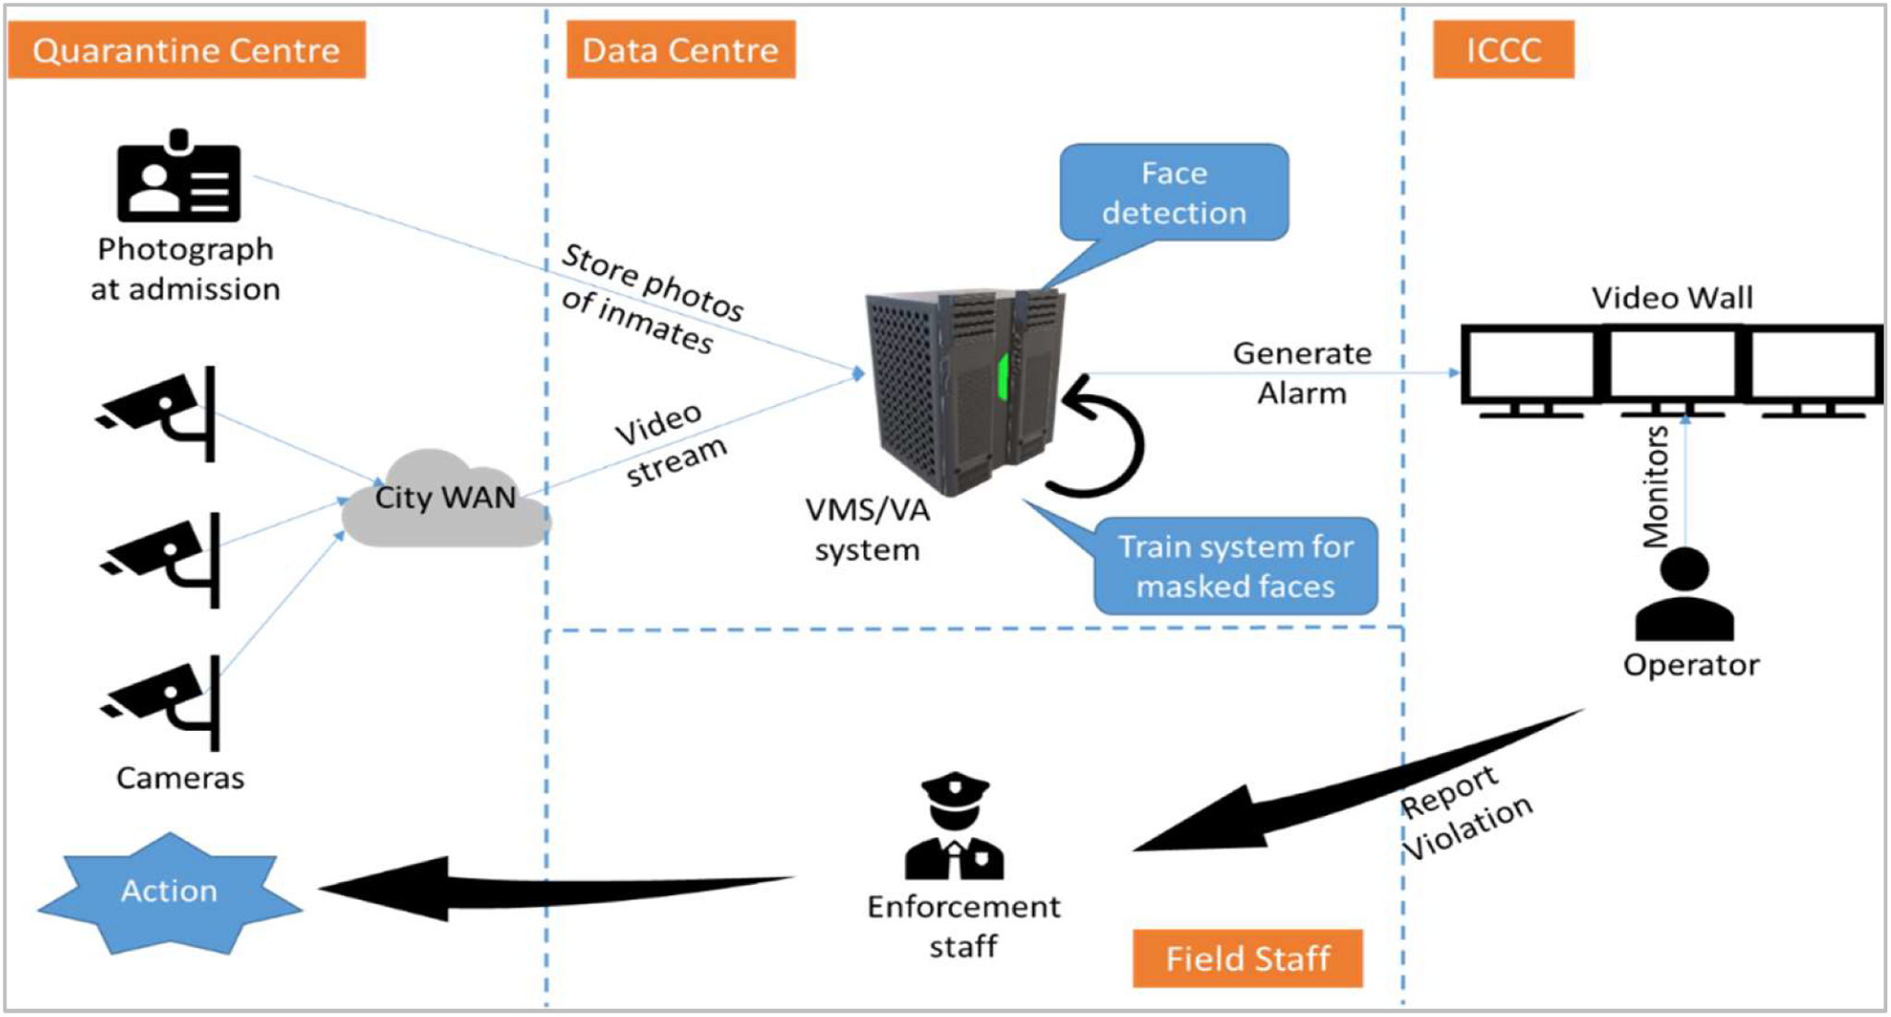
Quarantine centre surveillance system
Step 1: Installing CCTV cameras (typically 8-megapixel bullet cameras) at strategic locations such as entry and exit points, driveways, or the vehicle parking space within the quarantine centres identified by the authorities.
Step 2: Implementing an edge computing device for face recognition in the video stream.
Step 3: Periodically updating the edge computing device with the photograph of the quarantined citizens to be monitored and tracked.
Step 4: Monitoring the video stream centrally from these cameras at multiple quarantine centres through the edge computing device.
Step 5: Generating an alarm centrally at the ICCC if a quarantined person ventures out.

Slide 8
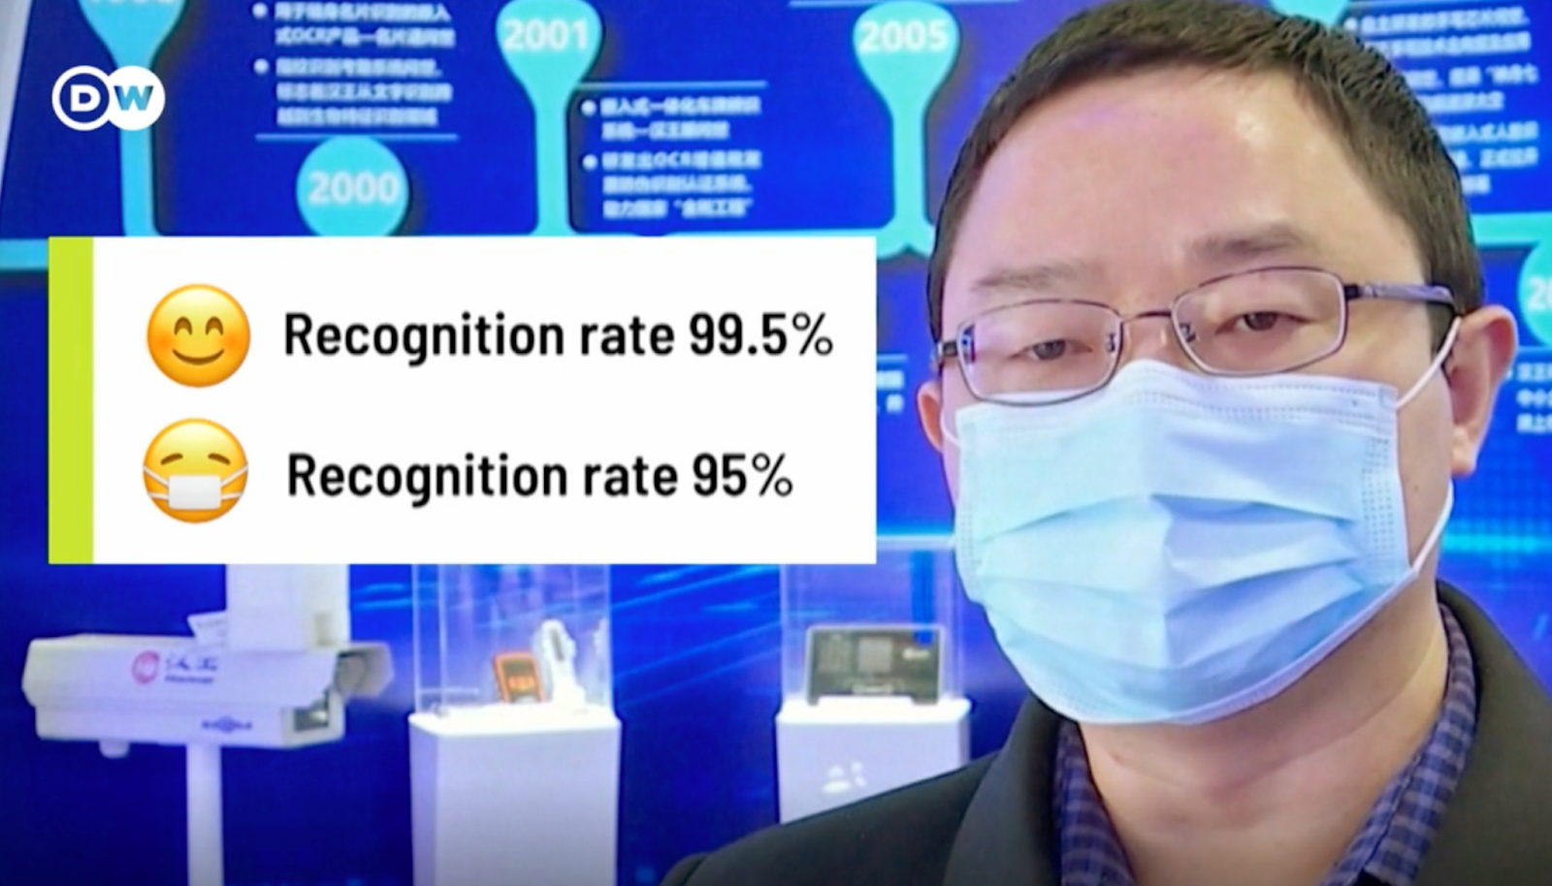
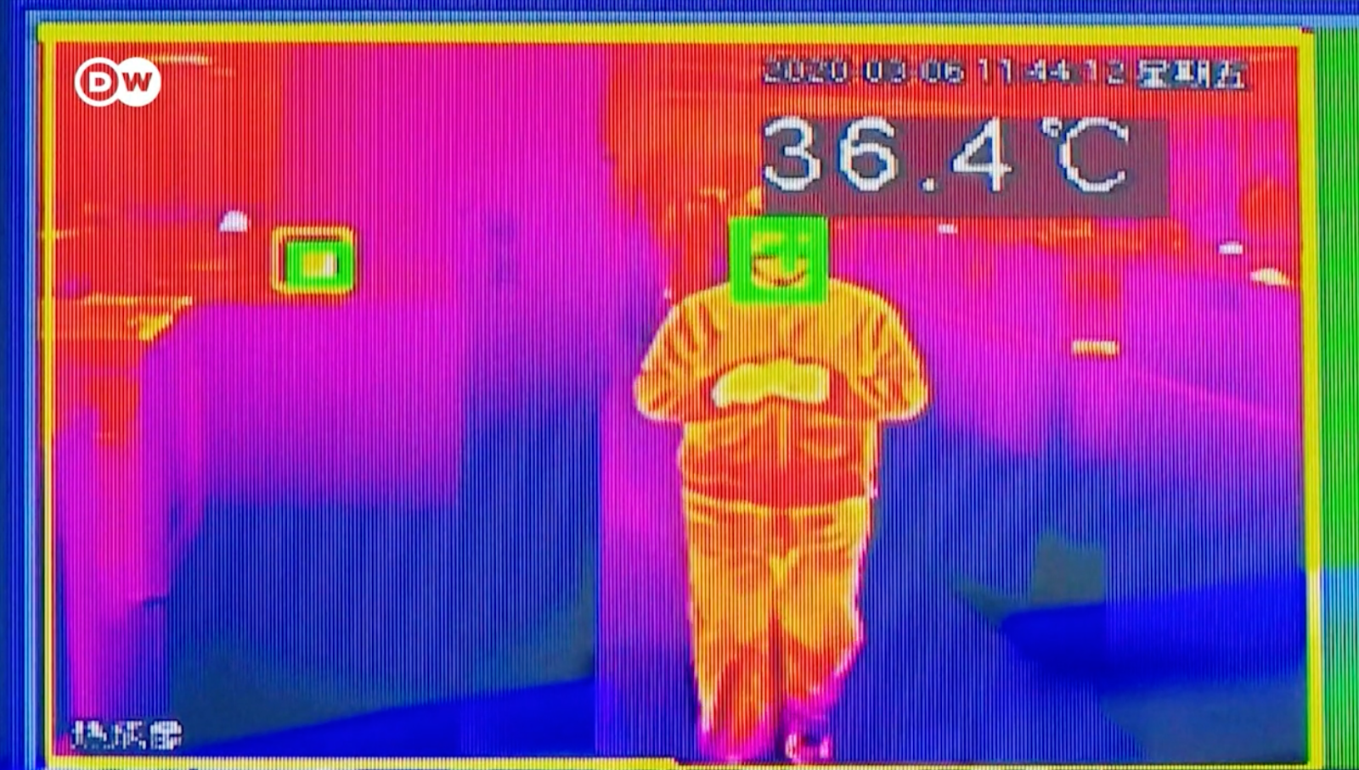
Facial recognition system
When people do not wear a mask the recognition rate is about 99.5%
When people wear a mask the recognition rate is about 95%
Cameras can also connect with temperature sensor, therefore, it can also measure person’s body temperature and check if someone has a fever.

Slide 9
2.2. qR health code
Health qR code impact on covid-19?
How does the health QR code work?
What is the health QR code?

Slide 10
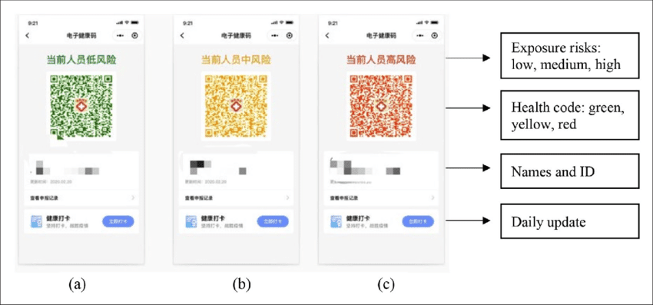
What is health QR code?
location
colors of Health QR code
resident’s name and resident’s identity card number
personal health state update button

Slide 11
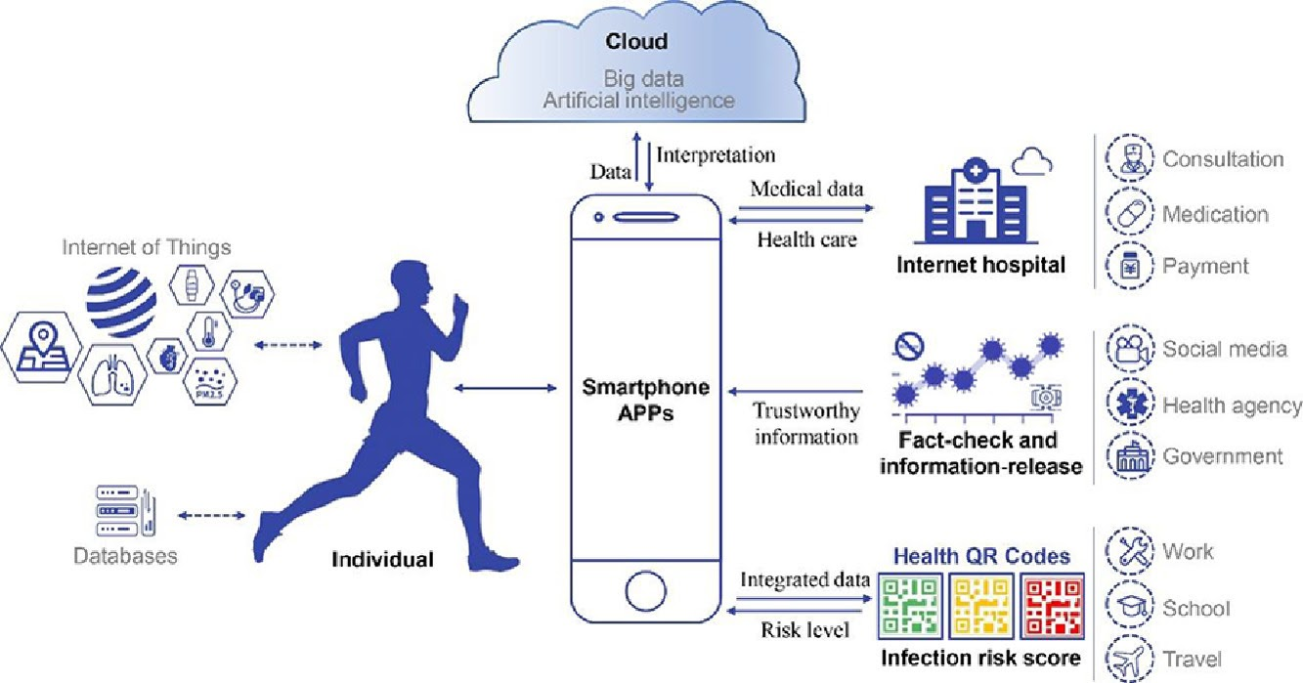
How does the health QR code work?
collect resident’s health state on a daily basis
collect resident’s medical records and pharmacy purchase records
tracking resident’s public transportation pathway

Slide 12

Health QR code impacT on covid-19
Contact and movement pathway tracing
Exposure risk self-triage
Self-update of health status
Prevention of COVID-19 transmission
Improve the efficiency and safety of pandemic prevention

Slide 13
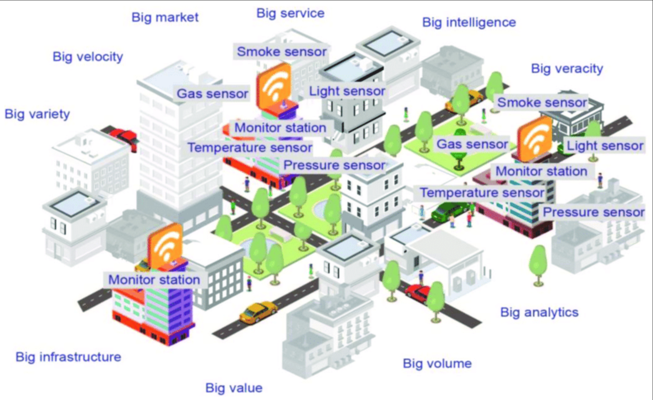
Sensors across smarT cities
carpets of sensors across a city for autonomous cars (driverless cars)
apps car drivers crossing over a pothole
digital master plans for city designs
structure sensors for sustainable buildings
landing posts (utility poles) connected to underground, optical wiring that could provide neighborhood with LED street lighting
process parking transactions
service and data lists serving as electronic neighborhood bulletin boards

Slide 14
Objectives and purposes of sensor technology
Make use of these building-block like components
Provide an interface to the computerized “monitoring” capability for each given function
Have a full structure or service supplied

Slide 15
Sensor data collection
Energy Monitoring Management (73 MB)
Noise Monitoring Management (578 KB)
Urban Lab Monitoring Management (153 KB)
Garbage Collection Management (480 KB)
Parking Spots Management (615 KB)

Slide 16
“Urban morphology is the study of the form of human settlements and the process of their formation and transformation.” [4]

Slide 17
Characteristics of virus propagation models
SI model: system individuals are divided into two categories, susceptible individual (S) and infectious individual (I)
SIS model: based on the above model it creates a new situation that infected individuals recover and return to the susceptible state again
SIR model: R is the number of recovered or immunized individuals
SIRS model: proposes the situation where the individual R who has gained immunity loses immunity with a probability which is r
SEIR model: after susceptible individual S is infected susceptible individual S becomes exposed state E with a certain probability α and then becomes infectious state I with a certain probability β

Slide 18
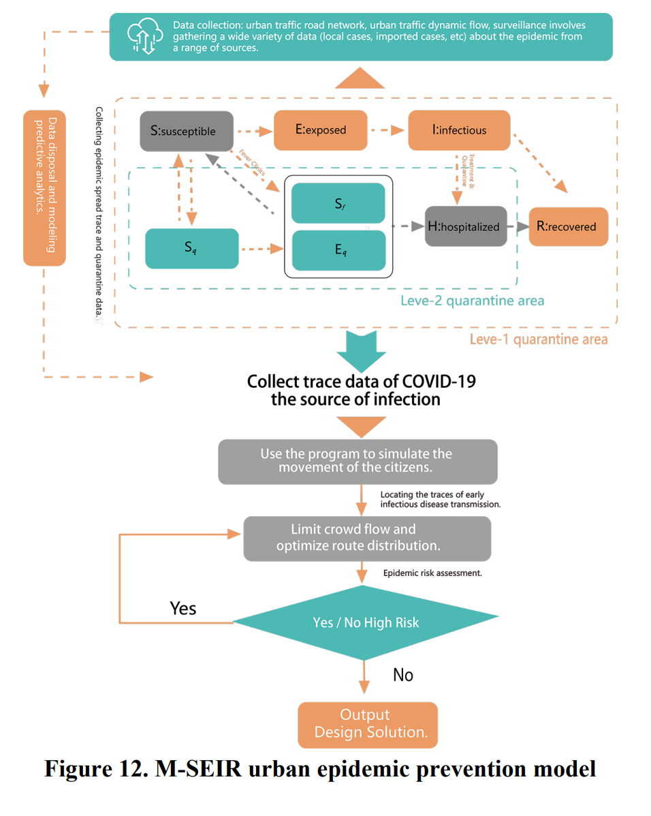
The M-sEIR model
M-SEIR model: the population is mainly divided into susceptible (S), Exposed (E), Infectious (I), Recovered (R), and hospitalized (H) groups
f is the rate of suspected cases
q is the quarantine rate of contacts population

Slide 19
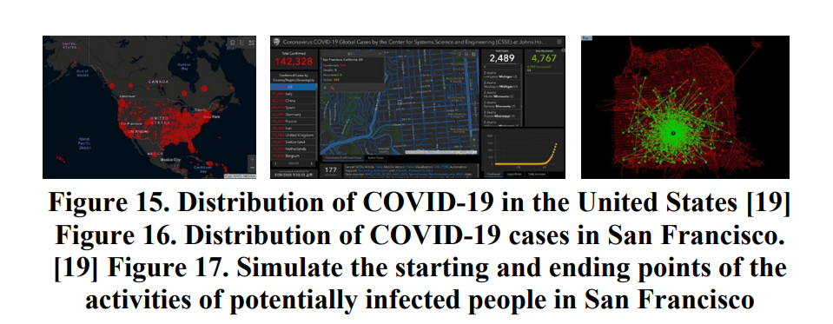
Simulation experiment on the transmission of covid-19 in sf

Slide 20
4. conclusion
In conclusion, with the use of the movement path tracking technologies and the urban morphology model we can prevent the spread of pandemics in smart cities.

Slide 21
references
[1] Zhang, X., Hou, H., Fu, Q., & Zhang, Y. (2020). Current Problems and Restructuring Suggestions for Smart City Construction: A Case Study on Fight against COVID-19 in Several Chinese Cities. 2020 The 11th International Conference on E-business, Management and Economics, 65-69.
[2] Roy, D., Agarwal, N., Mukherjee, A., Angne, J., Devarajan, R., & Nair, M. V. (2021). Utilizing Smart City Cyber-physical Infrastructure for Tracking and Monitoring Pandemics like COVID-19 with the ICCC as the Nerve Centre. Digital Government: Research and Practice, 2(1), 1-8.
[3] Money, W. H., & Cohen, S. (2019). Leveraging AI and Sensor Fabrics to Evolve Smart City Solution Designs. Companion Proceedings of the 2019 World Wide Web Conference, 117-122.
[4] Zhiming, N., & Song, Q. (2020) System Design of Safety Road Network in Urban Morphology Prevention During COVID-19 Based on Digital Simulation Technology. Proceedings of the 2020 2nd International Conference on Big Data Engineering, 131-137.
[5] Wu, J., Xie, X., Yang, L., Xu, X., Cai, Y., & Wang, T. (2021). Mobile Health Technology Combats COVID-19 in China. Journal of Infection, 82(1), 159-198.

Slide 22
Thank you!

